Slide 1
The Lamb
William Blake
第四组：陈怡冰、张曼曼、连诗曼、石语萱、黄艳琴

Slide 2

01
02
03
04
Introduction
Analysis
Translate
Compare and Comment
introduce the poet
analyse the poem's form and meaning with emphasis put on speaker and tone
translate the poem
compare and comment on previous translations

Slide 3
Part 01
Introduction
THE LAMB
introduce the poet

Slide 4
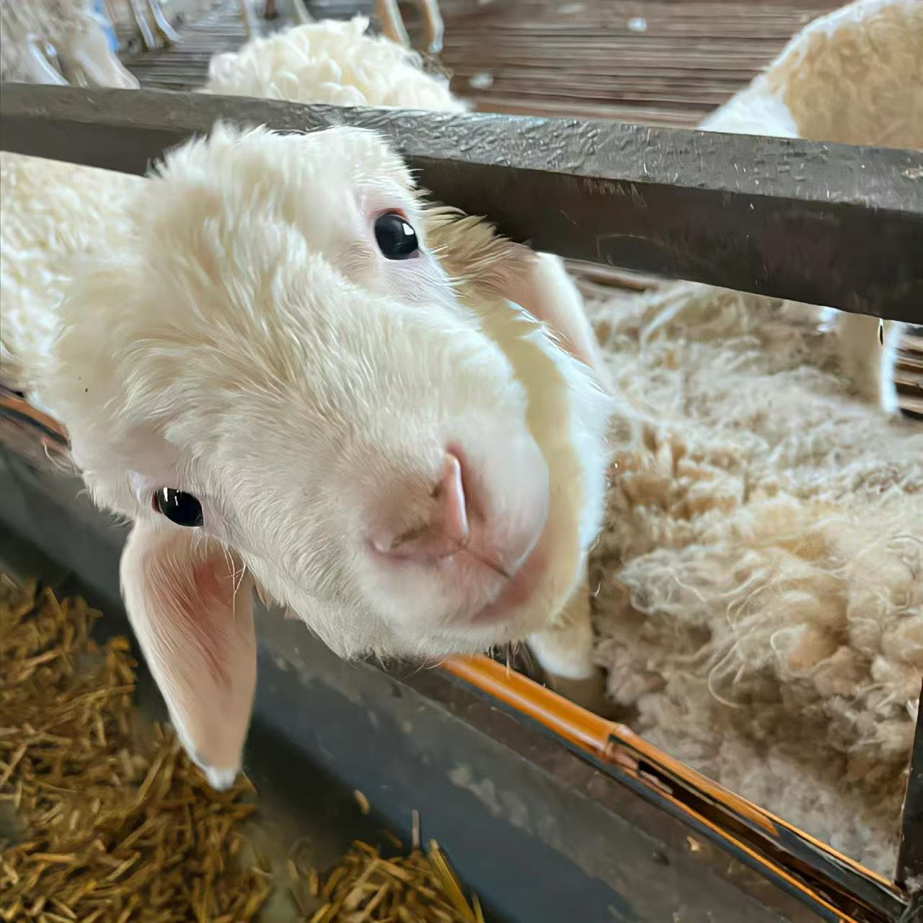
Part 01
The Lamb
Little Lamb who made thee
Dost thou know who made thee
Gave thee life & bid thee feed,
By the stream & o'er the mead;
Gave thee clothing of delight,
Softest clothing wooly bright;
Gave thee such a tender voice,
Making all the vales rejoice;
Little Lamb who made thee
Dost thou know who made thee
Little Lamb I'll tell thee,
Little Lamb I'll tell thee;
He is called by thy name,
For he calls himself a Lamb:
He is meek & he is mild,
He became a little child:
I a child & thou a lamb,
We are called by his name.
Little Lamb God bless thee.
Little Lamb God bless thee.

Slide 5
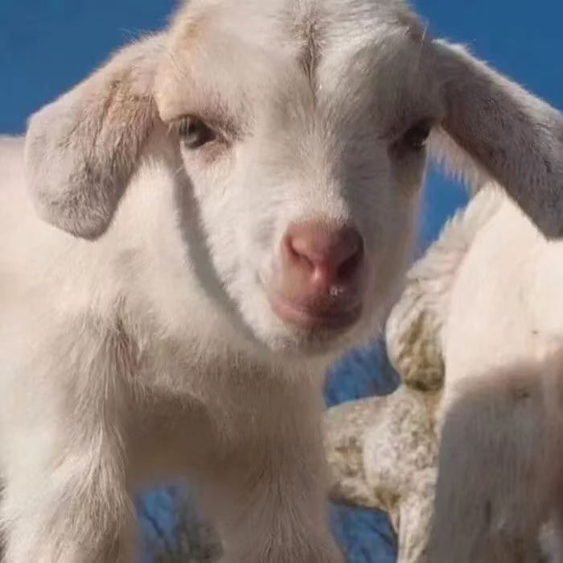
Part 01
An Innocent Inquiry: The Lamb's Gentle Charm
William Blake's "The Lamb" is a disarmingly simple poem, radiating an aura of innocence and childlike wonder. The poem begins as a gentle question posed to a lamb, inquiring about its creator, and evolves into a tender affirmation of God's presence in both the natural world and humanity. The tone is initially inquisitive and then shifts to one of peaceful revelation and blessing. It's a poem that seeks to understand creation through the lens of faith and pure, untainted observation.
威廉·布莱克的《羔羊》是一首简单得令人心旷神逸的诗，散发着纯真和孩童般的惊奇。这首诗以一个温柔的问题开始，向一只羊羔询问它的创造者，然后演变成对上帝在自然界和人类中存在的温柔肯定。最初的语气是好奇的，然后转变为和平的启示和祝福。这首诗试图通过信仰的镜头和纯粹、无污点的观察来理解创造。

Slide 6
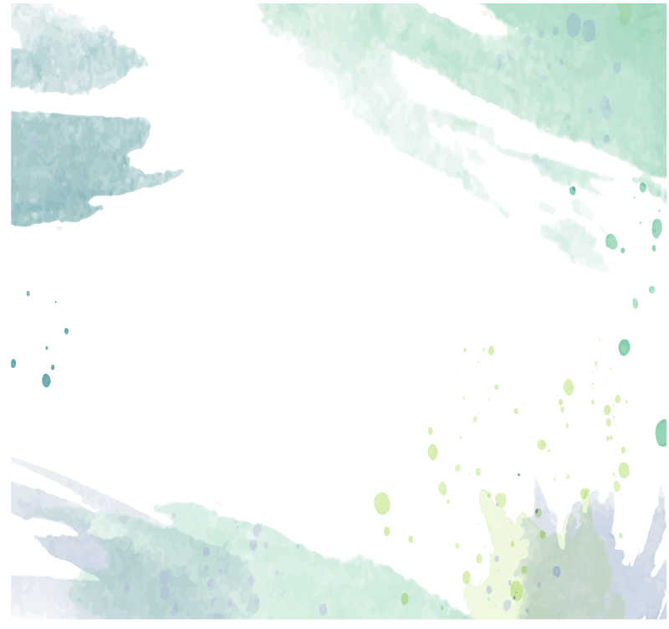
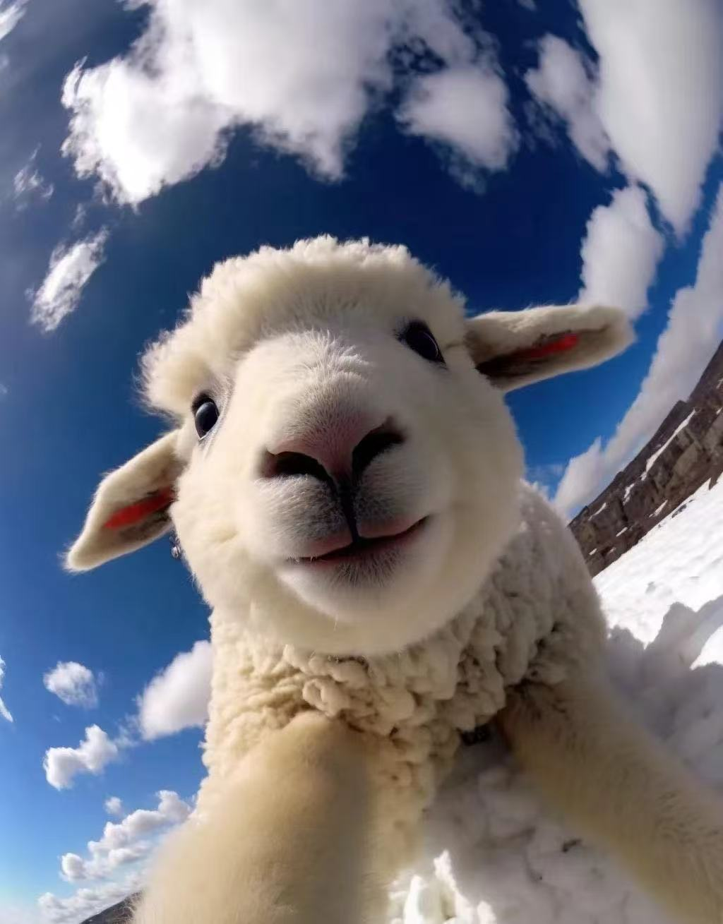
Part 01
Blake's Vision: Songs of Innocence
布莱克的《天真无邪之歌》中出现了“羔羊”，反映了一个孩子眼中的世界，在经历的腐蚀影响之前。这是一个内在善良和神圣联系的时代，没有被社会结构和工业化所破坏。理解布莱克对教会和国家腐败的强烈看法，有助于人们欣赏这首诗中纯真、纯洁的信仰观，将信仰视为与神的直接联系，超越了正式制度的束缚.
Blake's "Songs of Innocence," where "The Lamb" appears, reflects a world seen through the eyes of a child, before the corrupting influence of experience. It's a time of inherent goodness and divine connection, unspoiled by societal structures and industrialization. Understanding Blake's strong views on the corruption of the church and state helps one appreciate the poem's innocent, untarnished view of faith as a direct connection to the divine, outside the constraints of formal institutions.

Slide 7

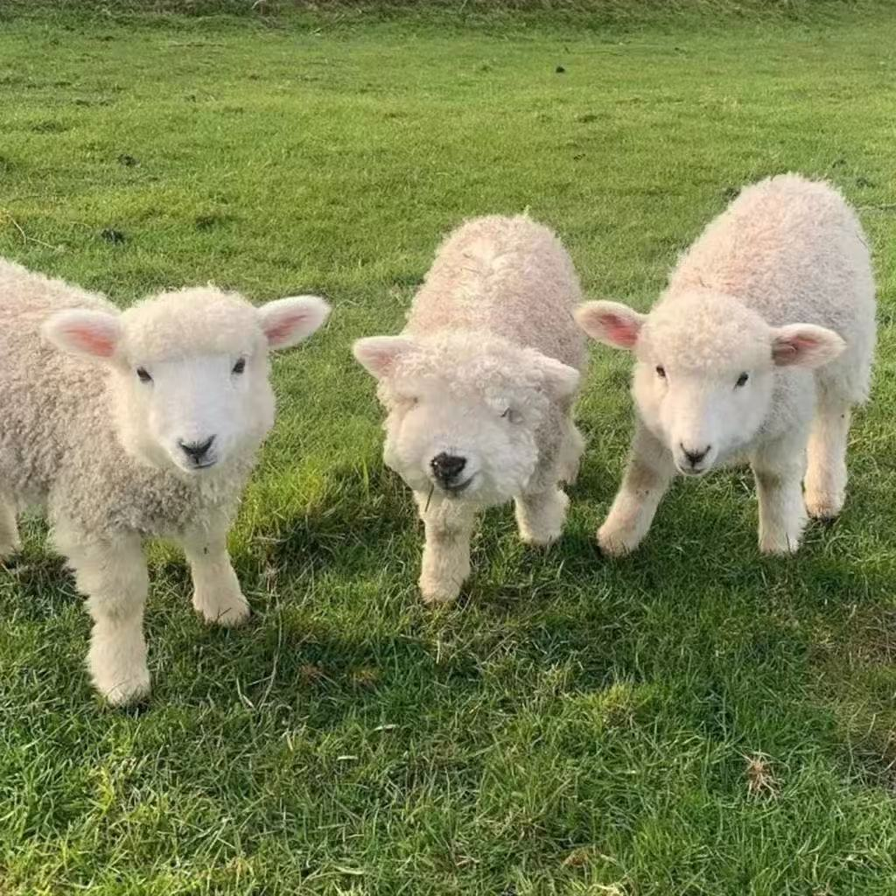
Part 01
The Divinity of Creation and Innocence
One primary theme explored in "The Lamb" is the inherent divinity of creation. The poem meticulously lists the gifts bestowed upon the lamb: "life," "clothing of delight," a "tender voice." These blessings are presented as direct acts of a benevolent creator. Another central theme is innocence itself. The lamb embodies purity, gentleness, and a natural connection to God. The speaker, a child, also shares in this innocence. Finally, the poem touches upon the theme of divine incarnation, linking the lamb to Jesus Christ, who is also referred to as the Lamb of God, and who took on the form of a child. This connection emphasizes the idea that divinity can be found in the simplest and most innocent forms.
《羔羊》探讨的一个主要主题是创造的内在神性。这首诗精心地列出了赋予羔羊的礼物：“生命”、“快乐的衣服”、“温柔的声音”。这些祝福被呈现为仁慈造物主的直接行为。另一个中心主题是纯真本身。羔羊象征着纯洁、温柔和与上帝的自然联系。说话的人，一个孩子，也分享着这种纯真。最后，这首诗触及了神圣化身的主题，将羔羊与耶稣基督联系起来，耶稣基督也被称为上帝的羔羊，他以孩子的形式出现。这种联系强调了神可以在最简单和最纯真的形式中被发现的想法。

Slide 8
Part 02
Analysis
THE LAMB
analyse the poem's form and meaning with emphasis put on speaker and tone

Slide 9
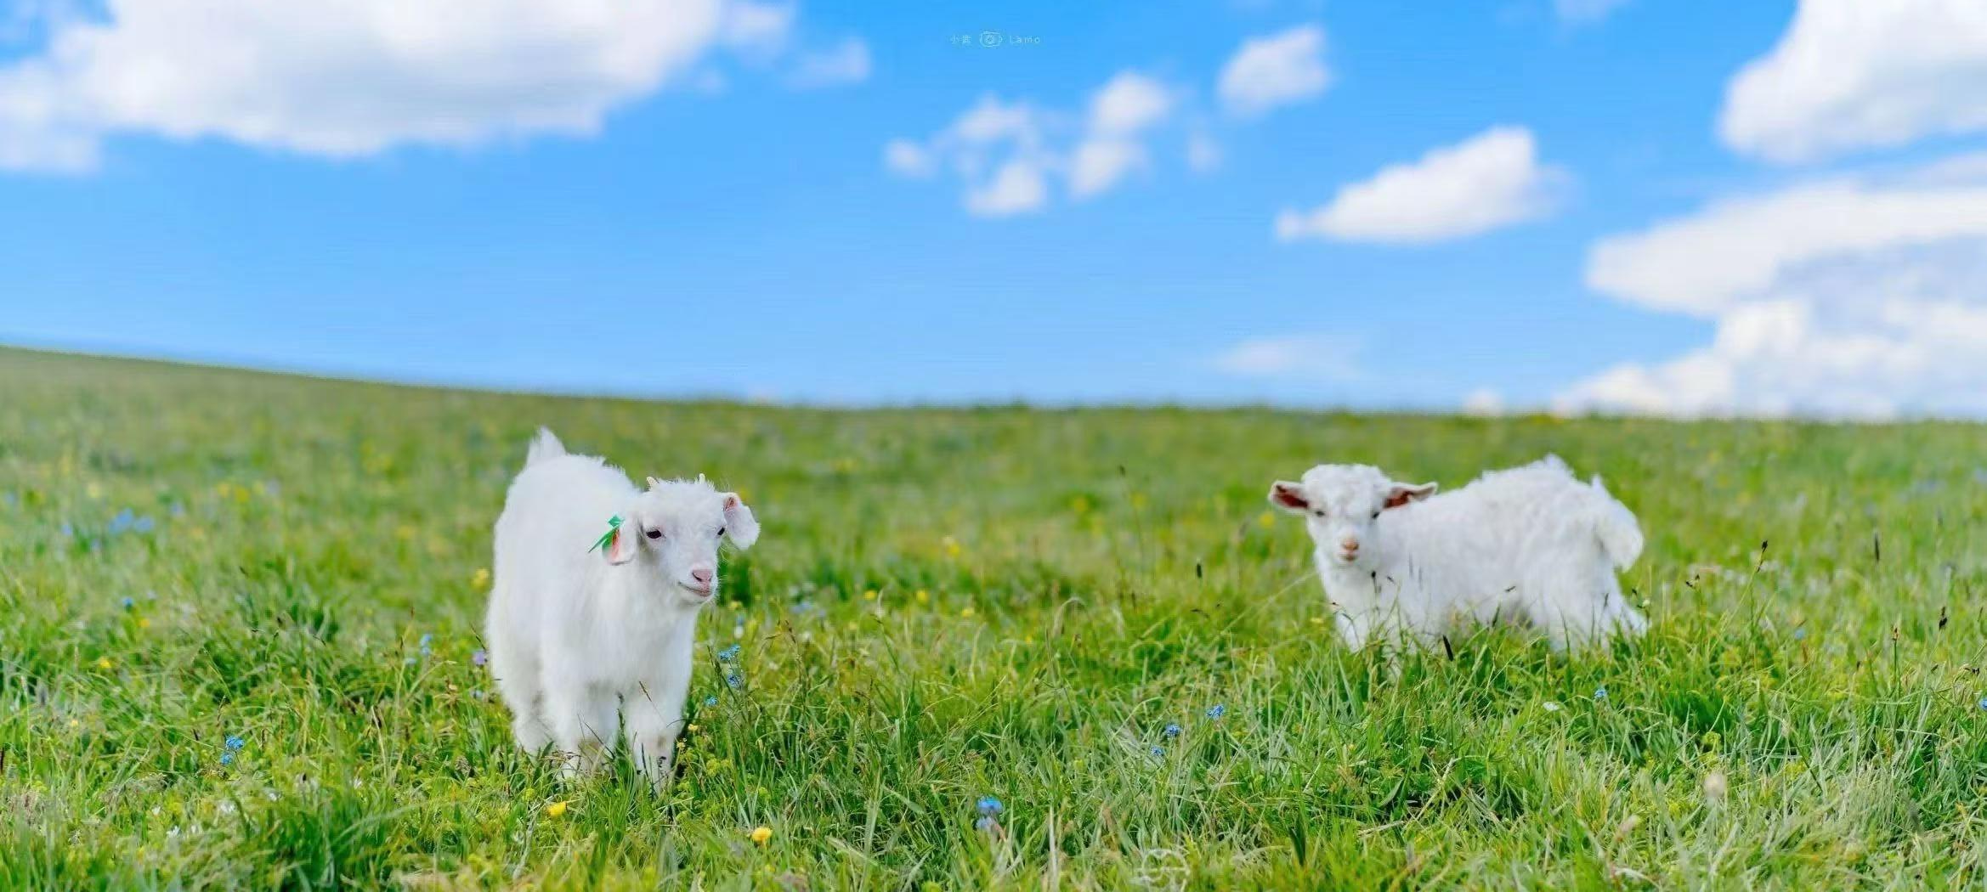
Part 02
一、 Poem Form (形式分析):Blake’s "The Lamb" follows a highly structured and accessible form, which reinforces its childlike, innocent theme:
1.Stanza & Line Structure
2.Rhyme Scheme
The poem consists of two 10-line stanzas (decets), with a consistent line length (short, 6-8 syllables per line). This symmetry creates a gentle, rhythmic flow, similar to a nursery rhyme or lullaby.
It uses a simple AABB rhyme scheme (e.g., "lamb" / "name", "feed" / "mead" in Stanza 1; "voice" / "choice", "bright" / "delight" in Stanza 2). The repetitive, predictable rhymes enhance the poem’s warmth and approachability, fitting its innocent subject.
3.Meter
Primarily written in trochaic tetrameter (lines start with a stressed syllable followed by an unstressed one, e.g., "LIT-tle LAMB, who MADE thee?"). This meter mimics a soft, steady beat—like a parent’s gentle voice when speaking to a child.

Slide 10
Part 02
二、Speaker (说话者分析):The speaker of "The Lamb" is best interpreted as a young child (or a voice with childlike innocence):
02
03
01
Evidence from Diction
Role in the Poem
Perspective
The speaker uses simple, naive language (e.g., "little lamb", "softest clothing wooly bright") and asks direct, uncomplicated questions ("Who made thee?", "Dost thou know who made thee?"). These choices reflect a child’s curiosity about the natural world, not the complex reasoning of an adult.
The speaker addresses the lamb as an equal—talking to it as a friend rather than a "lower" creature. This lack of hierarchy is typical of a child’s worldview, where nature feels personal and intimate.
The child’s voice acts as a bridge between the lamb (a symbol of innocence) and the divine (the "Maker"). By asking about the lamb’s creator, the speaker leads the reader to connect innocence in nature to spiritual purity.

Slide 11
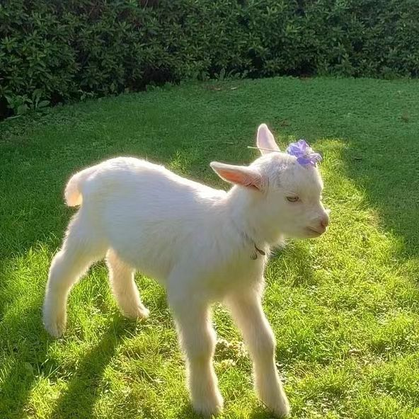
Part 02
三、Tone (语气分析):The tone of the poem is warm, reverent, and innocent—consistent with the speaker’s identity and the poem’s theme:
1.Warmth: The description of the lamb ("softest clothing", "tender voice") and the speaker’s gentle address ("I’ll tell thee") create a cozy, affectionate tone, as if the speaker is comforting or admiring the lamb.
2.Reverence: When the speaker reveals the lamb’s creator ("He is called by thy name, / For He calls Himself a Lamb"), the tone shifts to quiet awe. The capitalization of "He" (referring to God) and the link between the lamb and the divine (Jesus, often called the "Lamb of God") convey deep respect for spirituality.
3.Innocence: There is no cynicism or complexity in the tone. The speaker’s curiosity is pure, and the poem avoids darker themes (unlike Blake’s later works in Songs of Experience). This innocence mirrors the lamb itself, tying form and content tightly together.

Slide 12

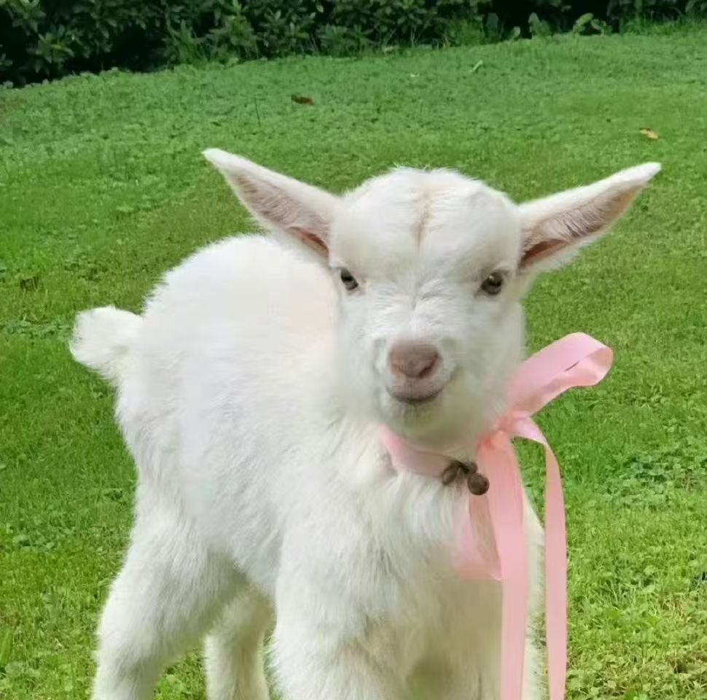
Part 02
四、Core Meaning (主题含义):The poem’s form, speaker, and tone all serve its central message: Innocence in nature is a reflection of divine goodness.
1.Blake uses the lamb as a symbol of "innocence" (a key theme in his Songs of Innocence collection). The lamb’s softness, gentleness, and simplicity are framed as gifts from God.
2.By having a child speak to the lamb, Blake suggests that spiritual truth is best understood through innocence—children, unburdened by adult doubt, can see the divine in ordinary, gentle things.
3.The final lines ("He is meek, and He is mild, / He became a little child") explicitly link God (and Jesus) to both the lamb and the child, emphasizing that "innocence" is not just a human or animal trait, but a divine one.

Slide 13
Part 03
Translate
THE LAMB
translate the poem

Slide 14
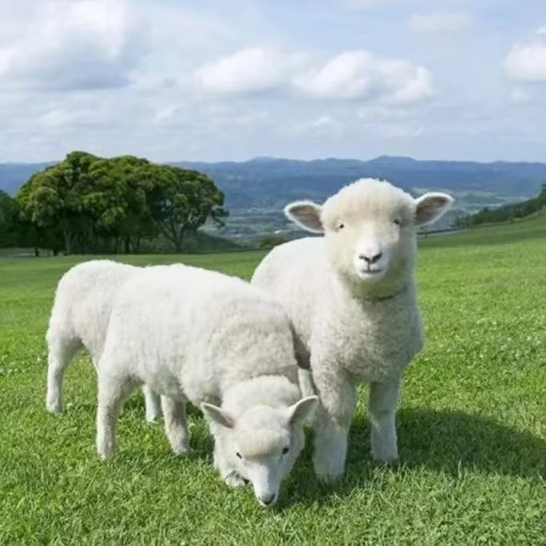
Part 03
Translation of "The Lamb" :
《羔羊》
小羔羊，谁创造了你？
你可知道谁创造了你？
赋予你生命，让你吃草，
在溪流边，在草地上；
予你喜上眉梢，
衣裳柔软，毛茸光亮；
予你温柔嗓音，
让所有山谷都欢欣！
小羔羊，谁创造了你？
你可知道谁创造了你？
小羔羊，我来告诉你，
小羔羊，我来告诉你！
他的名字与你一样，
因他自称是一只羔羊；
他温顺，他柔和，
他变成一个小孩子：
我为孩子，你是羔羊，
我们的名字同他一样。
小羔羊，愿上帝保佑你。
小羔羊，愿上帝保佑你。
Approach: A balance between literal and free translation
策略: 直译与意译结合，寻求平衡
Comparison and comment of Previous Translations:
Translating Blake requires balancingsound (rhyme/meter), sense (meaning), and spirit (theological theme).
翻译Blake需要平衡音韵（韵律/节奏）、意（含义）和精神（神学主题）。

Slide 15

Part 04
Translatecompare and comment
THE LAMB
translate the poemcompare and comment on previous translations.

Slide 16
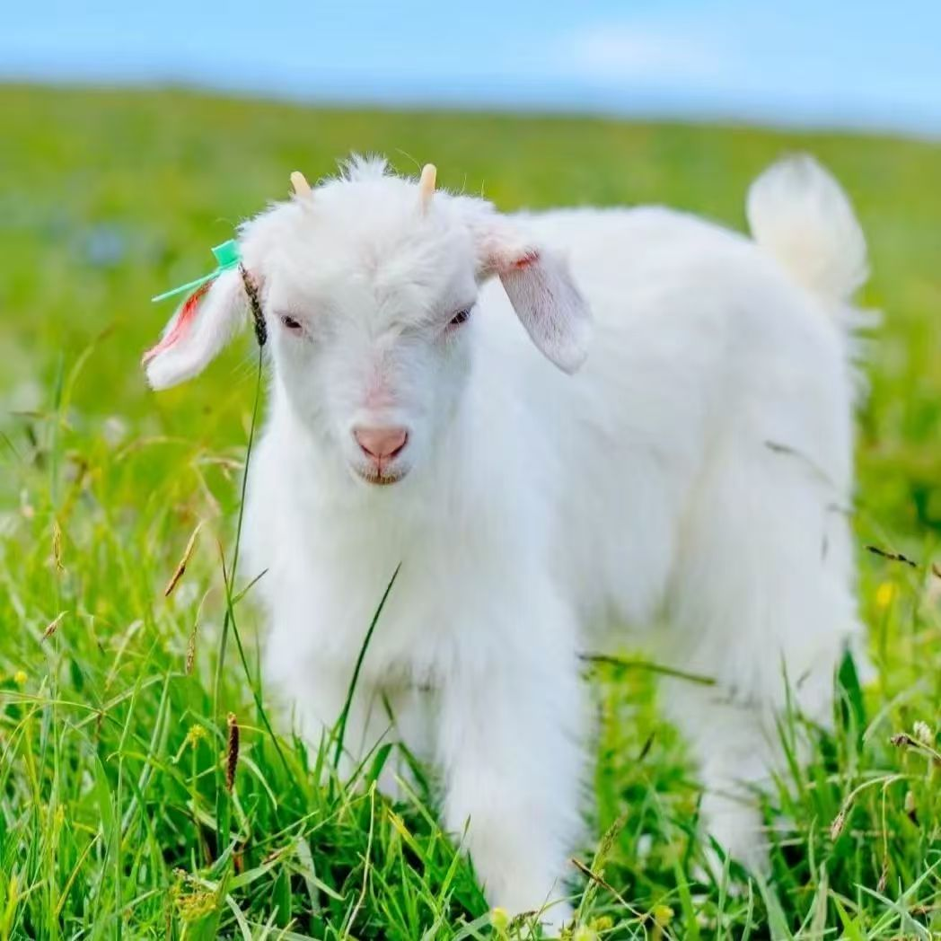
Part 04
《羔羊》
小羊羔谁创造了你
你可知道谁创造了你
给你生命，哺育着你
在溪流旁，在青草地；
给你穿上好看的衣裳，
最软的衣裳毛茸茸多漂亮；
给你这样温柔的声音，
让所有的山谷都开心；
小羔羊谁创造了你
你可知道谁创造了你；
小羔羊我要告诉你，
小羔羊我要告诉你；
他的名字跟你的一样，
他也称他自己是羔羊；
他又温顺又和蔼，
他变成了一个小小孩，
我是个小孩你是羔羊
咱俩的名字跟他一样。
小羔羊上帝保佑你。
小羔羊上帝保佑你。
Comparison 1: Yang Yi's Translation (杨苡译)（收录于诗集《杨宪益杨苡兄妹译诗》）
Approach: Fluent, natural, childlike domestication
策略: 流畅自然，富有童趣的本土化翻译

Slide 17
Part 04
01
02
03
02
Line Comparison 1:
Original: "Gave thee life & bid thee feed, / By the stream & o'er the mead;"
Yang's Version: “给你生命，哺育着你 / 在溪流旁，在青草地；”
Commentary : “哺育着你”增添了原文字面没有的“养育”动作，使画面更亲切，强调了呵护关系。
Line Comparison 2:
Original: "Gave thee clothing of delight, / Softest clothing wooly bright;"
Yang's Version: “给你穿上好看的衣裳， / 最软的衣裳毛茸茸多漂亮；”
Commentary: “好看的”、“毛茸茸多漂亮”用语口语化，充满童真和赞赏的口吻，非常符合“天真”的特质。
Line Comparison 3:
Original: "I a child & thou a lamb, / We are called by his name."
Yang's Version: “我是个小孩你是羔羊 / 咱俩的名字跟他一样。”
Commentary : “咱俩”这个代词极具口语色彩和亲和力，拉近了孩子、羔羊和读者之间的距离，生动体现了“一体”的概念。
Overall : 杨苡的译本优先考虑流畅性和童趣，采用归化策略，使译文读起来像一首自然的中文童谣，弱化了原诗的古语感和宗教术语，但精神内核（天真、关爱、一体）传达得非常好。

Slide 18

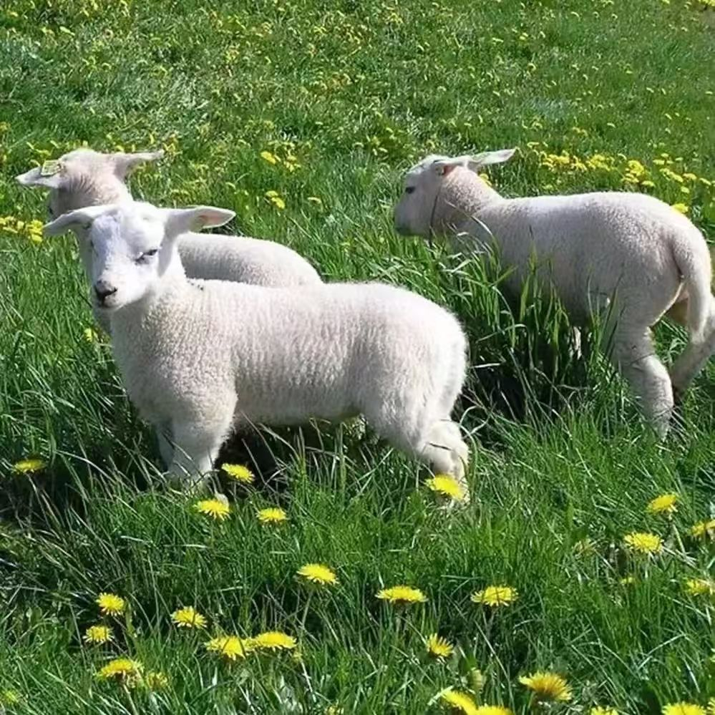
Part 04
《小羊》
小羊小羊谁造你，
你知道吗谁造你，
赐生命，赐青草，
还赐甘露甜如蜜。
喜乐身上披，
又松又暖羊毛衣，
轻声呼唤你，
山谷都惊喜。
小羊小羊谁造你，
你知道吗谁造你？
我来告诉你，
我来告诉你，
他共你一名——
他正是小羊。
他柔顺，他谦卑，
他降世作小宝贝，
正如你啊小羊羔，
我们都因他被召。
小羊小羊神爱你，
小羊小羊神祝福你。
Comparison 2: Jessica 's Translation(小秸) （网易）
Approach: Poetic innovation, focusing on imagery and rhythm
策略：诗化创新，侧重意象与节奏

Slide 19
Part 04
01
02
03
04
Line Comparison 1:
Original: "Gave thee life & bid thee feed, / By the stream & o'er the mead;"
Jessica's Version: “赐生命，赐青草， / 还赐甘露甜如蜜。”
Commentary : 创造性极强。将“feed”具体化为“青草”，并添加了“甘露甜如蜜”这一原诗没有的意象，极大地增强了感官体验和恩赐的甜美之感。
Line Comparison 2:
Original: "Gave thee clothing of delight, / Softest clothing wooly bright;"
Jessica's Version: “喜乐身上披， / 又松又暖羊毛衣”
Commentary: “喜乐身上披”处理得非常巧妙，将抽象名词“delight”转化为动词短语，既保留了“喜悦”之意，又承接了“披”上衣裳的动作，意境合一。“又松又暖”侧重于触感，非常贴切。
Line Comparison 3:
Original: "Making all the vales rejoice!"
Jessica's Version: “山谷都惊喜。”
Commentary: “惊喜”一词用得精妙生动，捕捉到了山谷因温柔声音而产生的瞬间反应。
Line Comparison 4:
Original: "We are called by his name."
Jessica's Version: “我们都因他被召。”
Commentary: “被召”是一个很强的神学词汇，比“以他之名”或“名字一样”更强调上帝的主动召唤和归属感， theological precision（神学精确性）更高。
Overall : 小秸的译本更注重诗意的再创造和语言的惊喜感，用词新颖大胆，节奏明快。在神学传达上，结尾处比杨苡译本更明显。
02

Slide 20
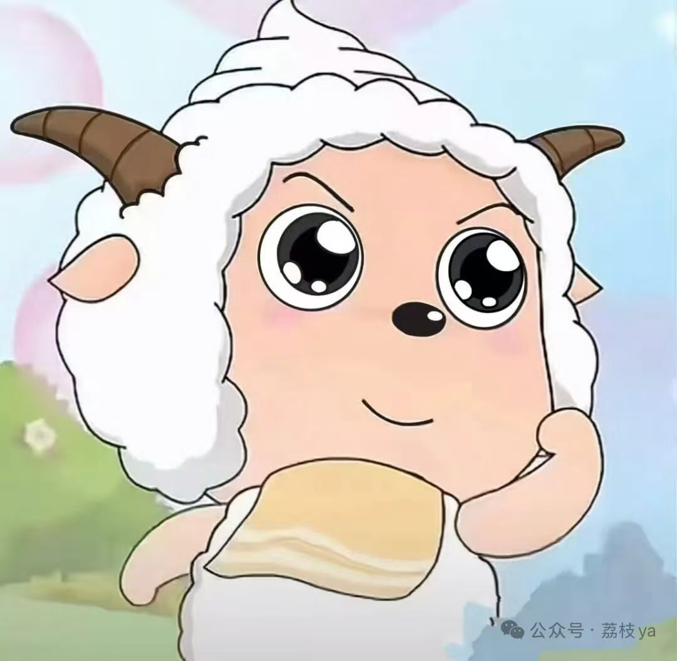
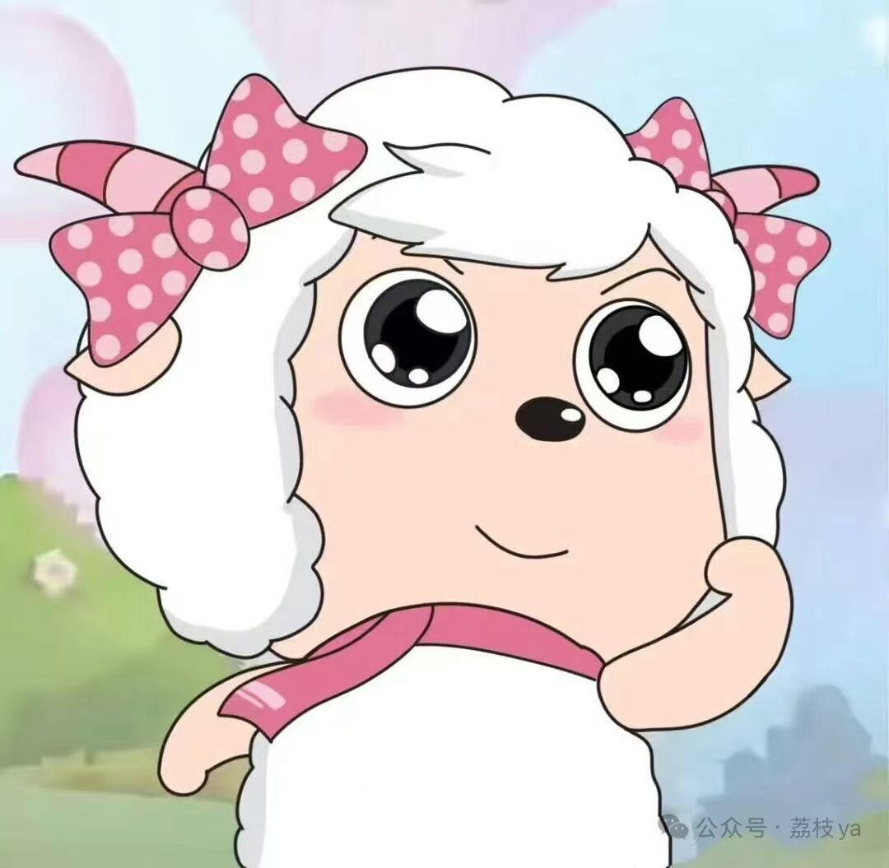
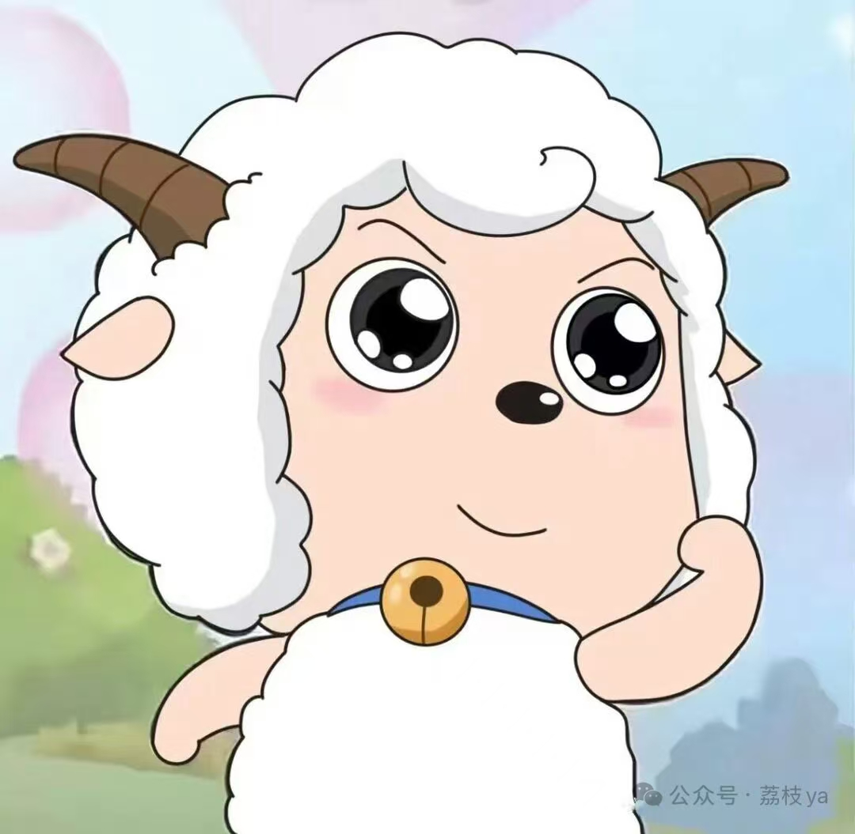
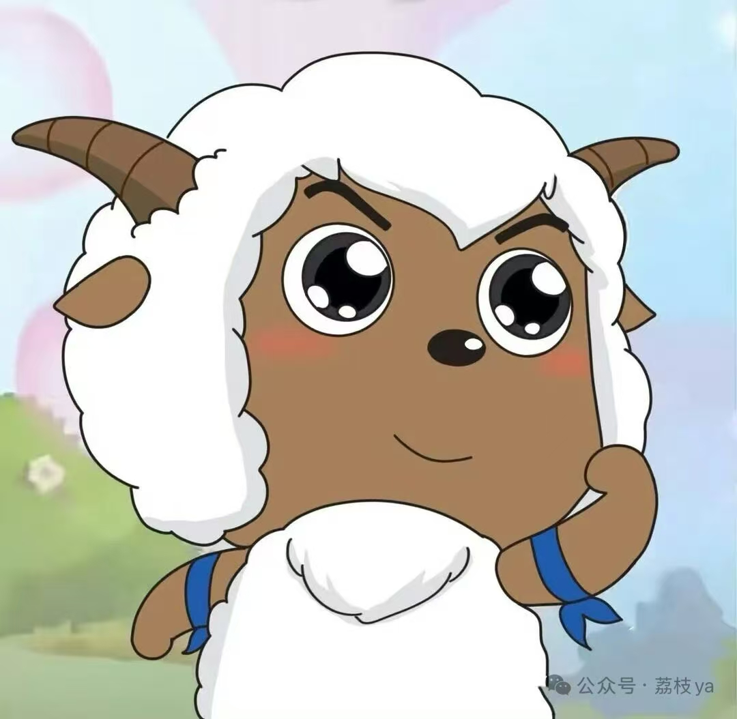
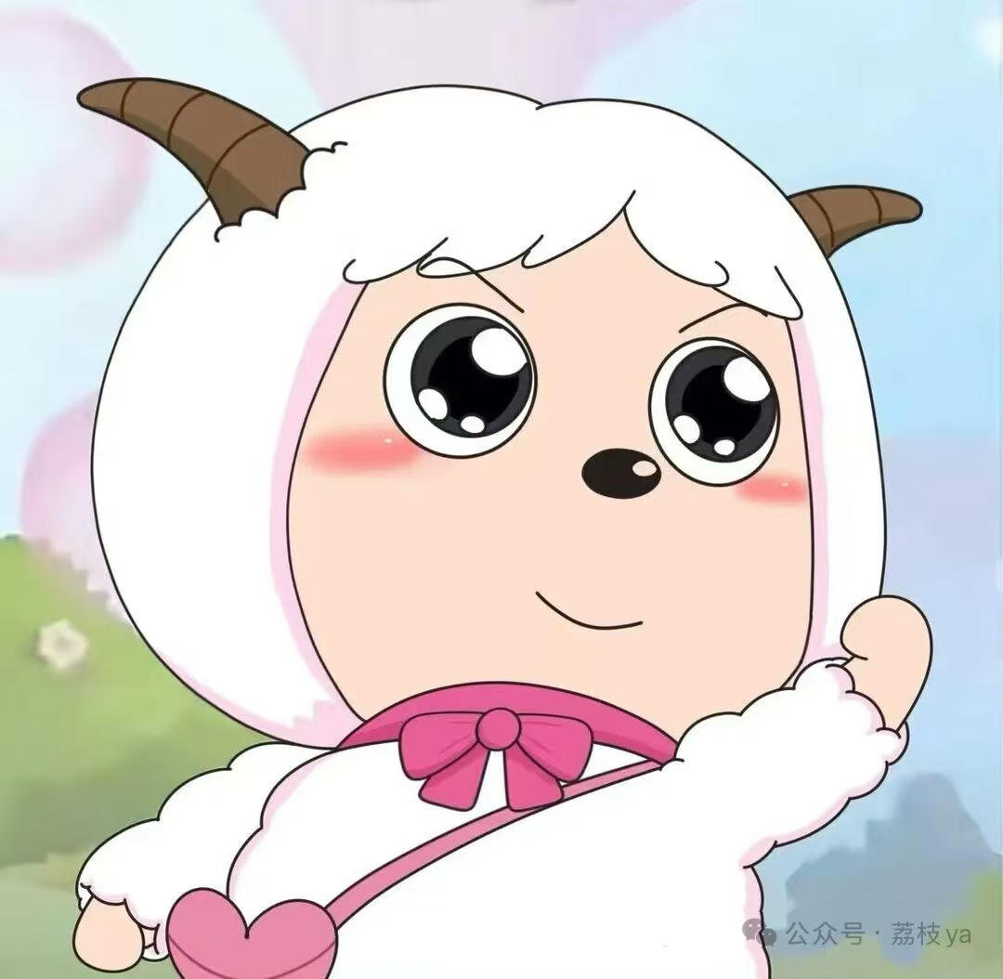
Part 04
Conclusion: The Multiplicity of Translation
There is no single "perfect" translation. Each version is a unique interpretation, refracting Blake's poem through the prism of the translator's style, era, and purpose.
没有唯一“完美”的翻译。每个版本都是独特的阐释，通过译者风格、时代和目的的棱镜折射出布莱克的诗歌。
Yang Yi gives us a nursery rhyme of pure innocence.
杨苡给了我们一首纯真无邪的童谣。
Jessica gives us a lyrical song rich with sensory imagery.
小秸给了我们一首充满感官意象的抒情歌。
Our Version also gives us a faithful yet personal reading.
我们的版本给出了一个忠实而又个人化的解读。
The enduring power of "The Lamb" lies in its ability to inspire this beautiful multiplicity of voices, all singing of the same wonder, creation, and love.
《羔羊》持久的魅力在于它能激发这种美妙的多元声音，所有这些声音都在歌颂同样的惊奇、创造与爱。
02

Slide 21
THANK YOU

